Slide 1
Grants Symposium & Alaska Infrastructure Planning
Ryan Anderson, Commissioner
April 11, 2022

Slide 2
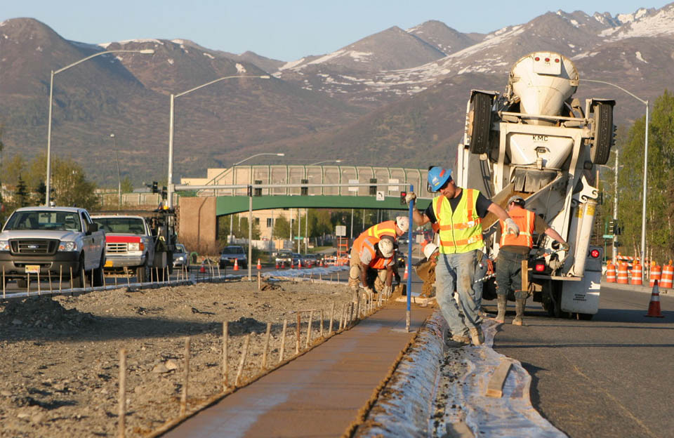
Work Zone Safety
April 11-15, 2022 is National Work Zone Awareness Week
Safety is crucial, and we work hard to minimize risks in Alaska’s work zones. Even so, Alaska averages over 120 work zone related crashes each year.
National statistics:
842 people were killed in 762 work zone crashes in 2019. 17% percent of those fatalities were work zone workers.
In 2015, a work zone crash occurred every 5.4 seconds.
70 work zone crashes occurred each day resulting in at least one injury
Tudor/Bragaw Intersection Improvement - median concrete installation. Photo by Kim Chong, Alaska DOT&PF

Slide 3
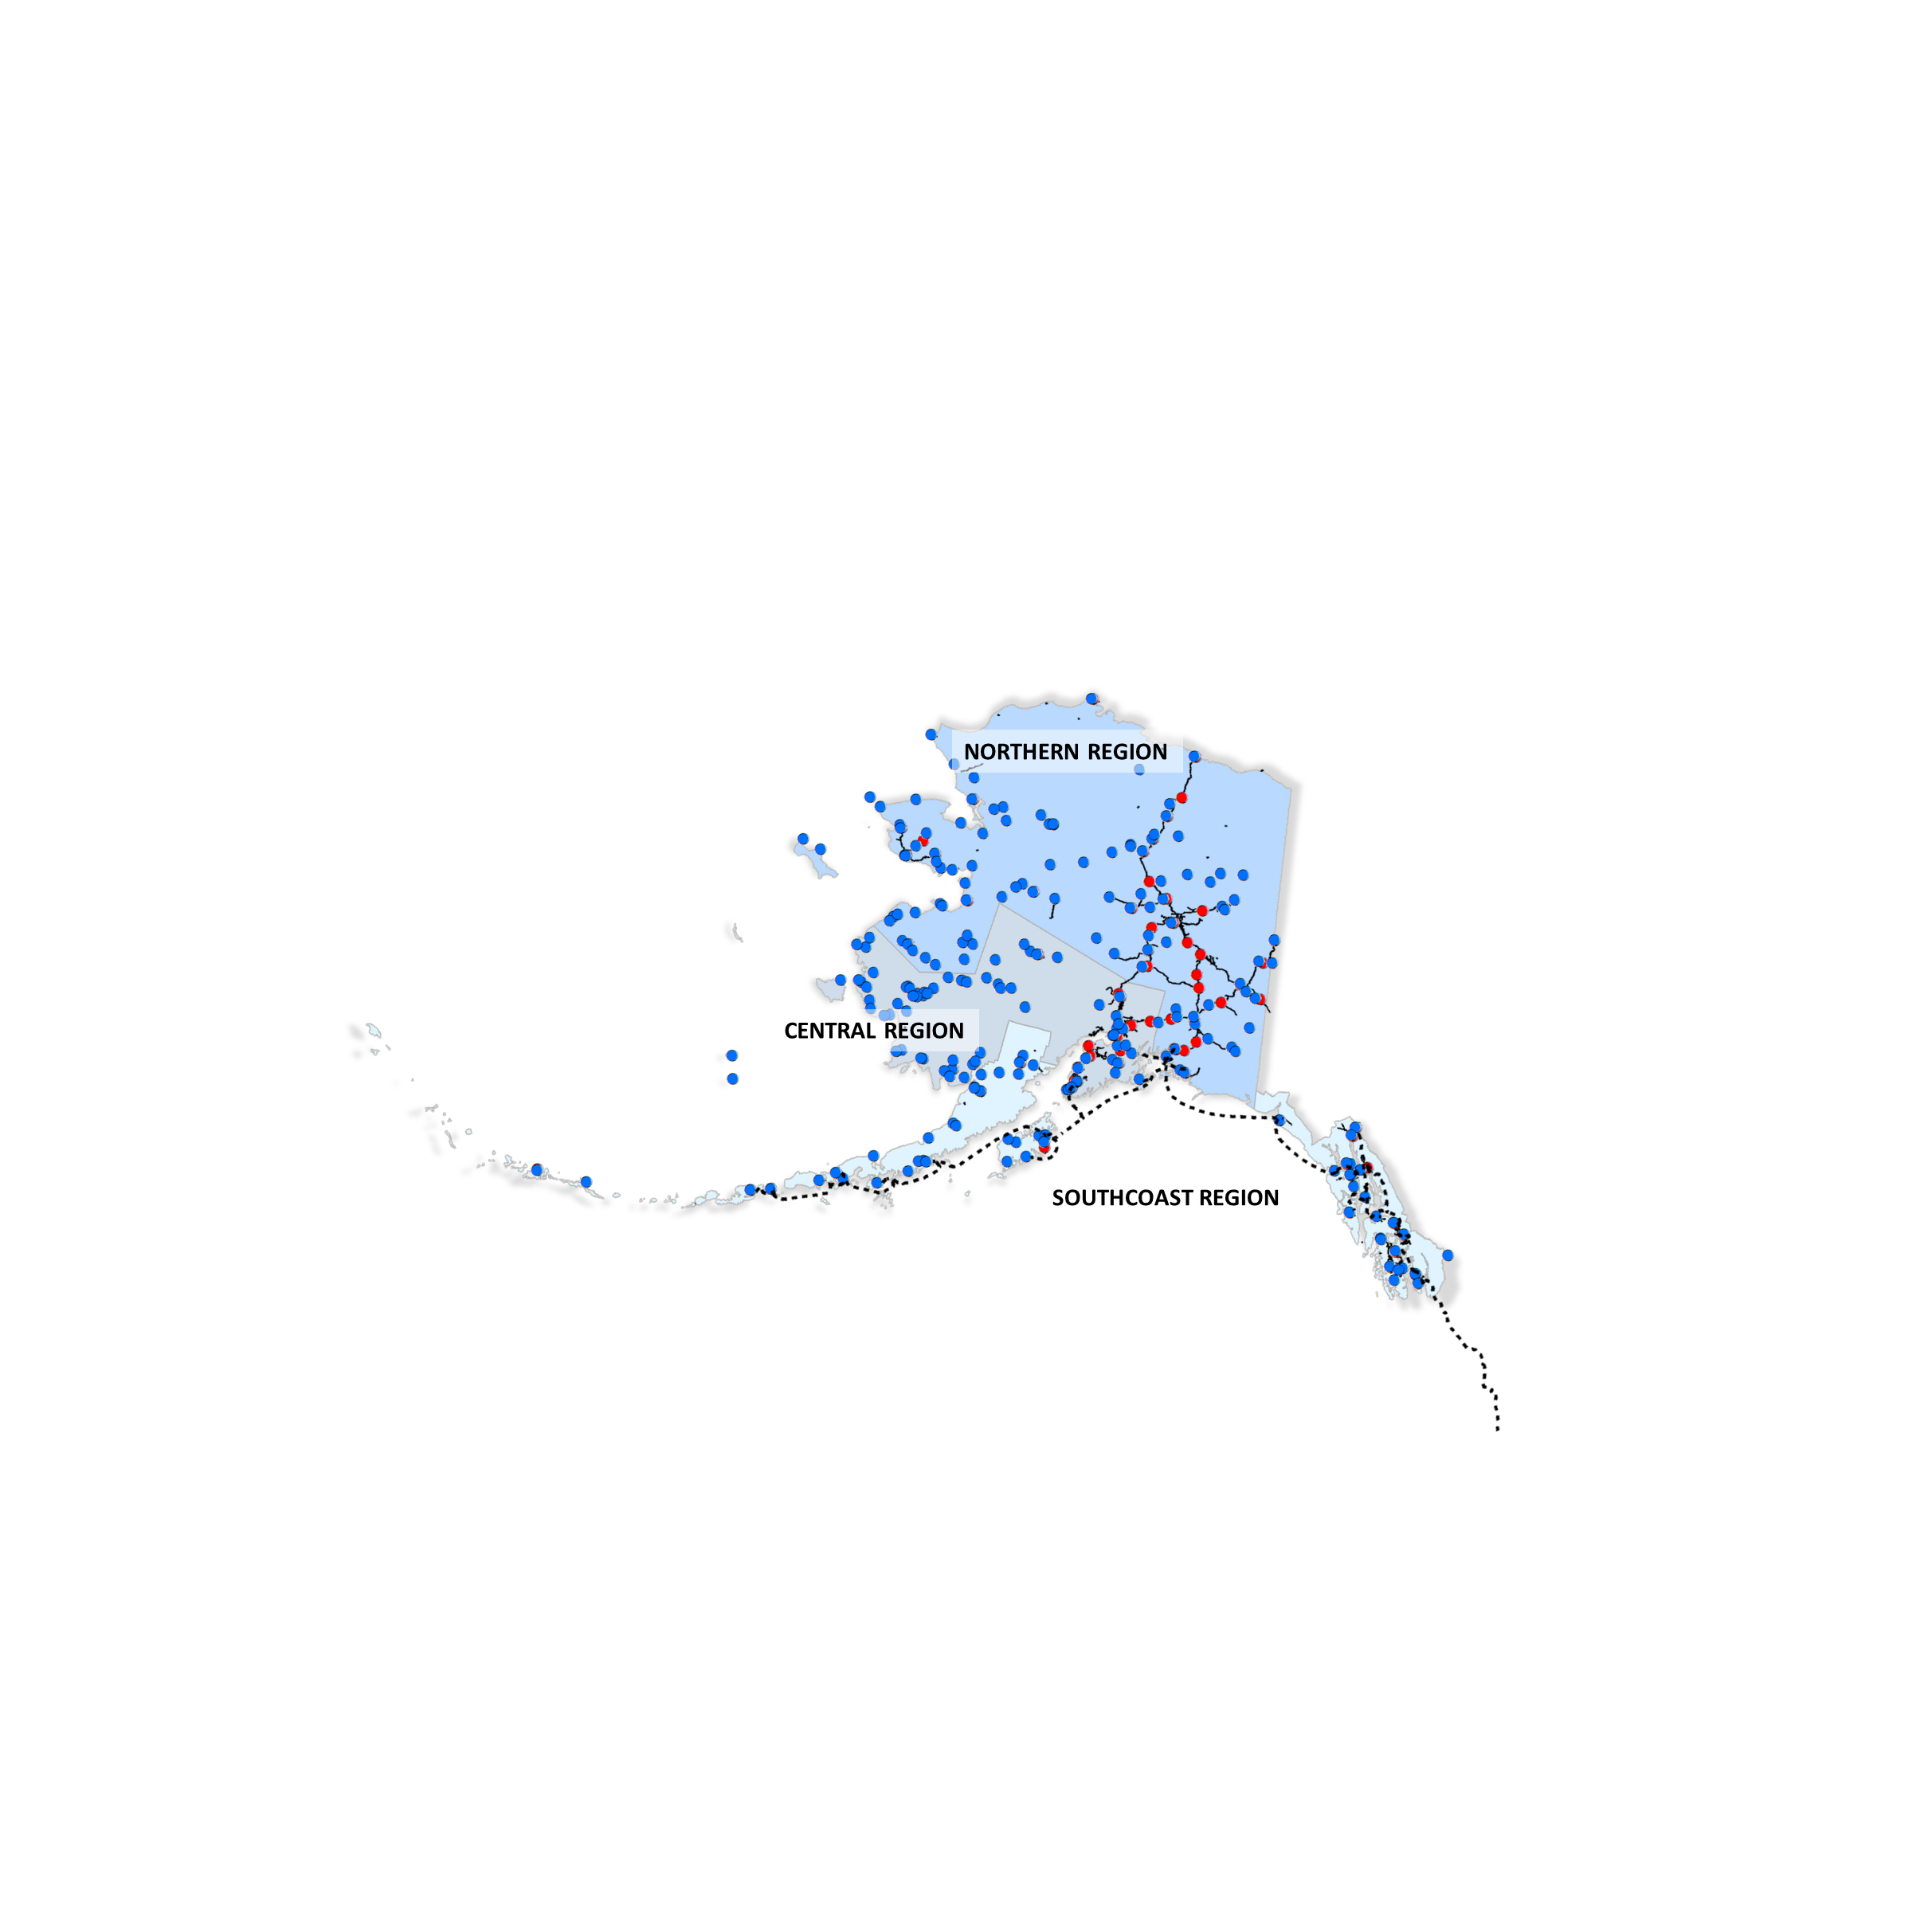
DOT&PF Regions
Geographically Diverse
High Seismic Activity
6 Distinct Climate Zones
Widespread and Varied Population Areas
Working with Rural Communities
Importance of Rural Airports
Multi-modal Transportation
Ice Roads
231 Tribes and Cultural Groups
Roads/Highways
M&O Stations
Airports
Marine Highway

Slide 4
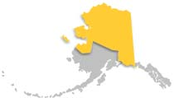
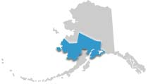
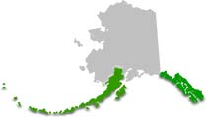
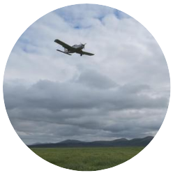
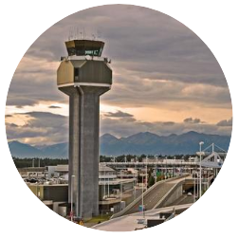
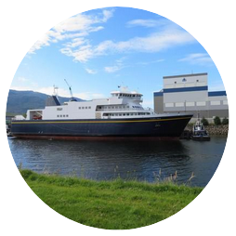
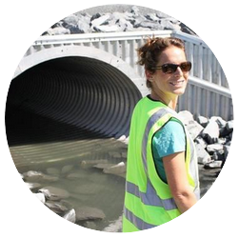
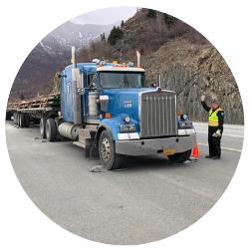
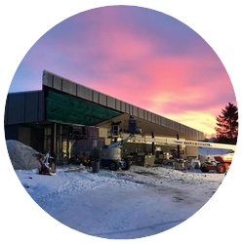
Alaska DOT&PF Structure
DOT&PF is divided into 3 geographic regions:
Northern (NR)
Central (CR)
Southcoast (SR)
Statewide Aviation
Alaska International Airport System
Alaska Marine Highway System ​
Design and Engineering Services
State Equipment Fleet​
Measurement Standards & Commercial Vehicle Compliance
Program Development
Facilities Services Division​

Slide 5
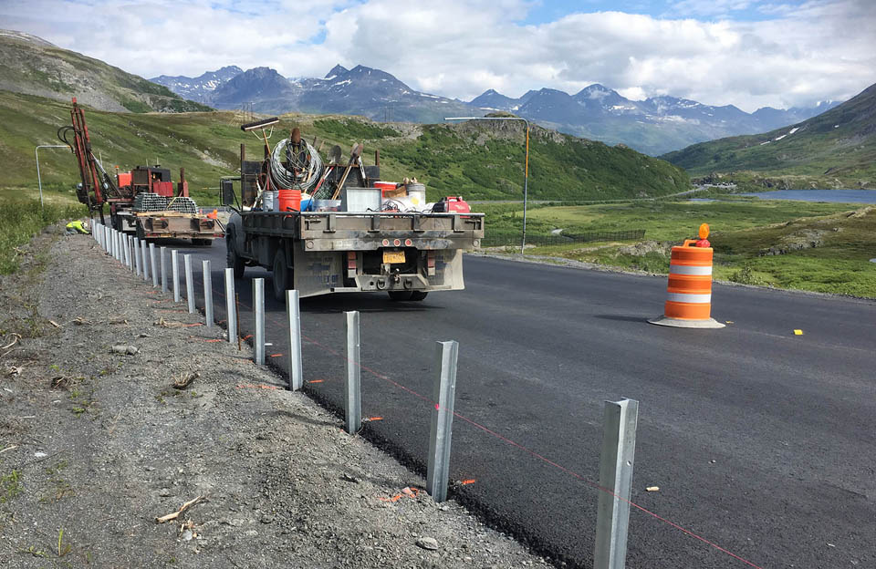
What Does IIJA Mean to DOT&PF
Alaska’s Share
New Highway Eligibilities
Reenergize the Alaska Marine Highway
Guardrail installation. Photo by Maddie Wenzlick, Alaska DOT&PF

Slide 6
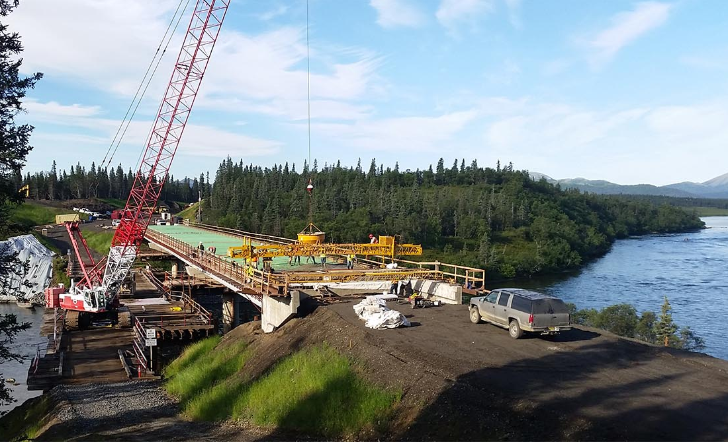
IIJA Discretionary Grant Opportunities
Rebuilding America’s Infrastructure with Sustainability and Equity (RAISE)
Multi-Modal Project Discretionary Grant
Airport Terminals
National Scenic Byways
America’s Marine Highway Program
Low Emissions Ferries
AKFederalFunding.org
Aleknagik Wood River Bridge, deck pour from slope on north shore. Photo by Justin Scott, Alaska DOT&PF

Slide 7
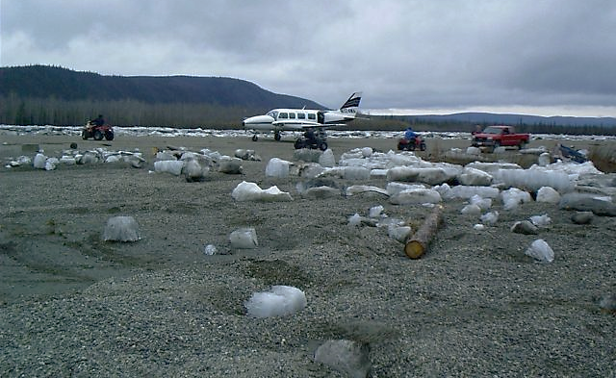
Partnerships: Discretionary Funding
Statewide Coordination & Prioritization
Project Bundling & Programs. DOT&PF can identify project bundling opportunities that make the package more competitive.
Scalability. DOT&PF has the ability to rapidly scale and mobilize staff to assist local governments.
Access to Professional Resources Access to professional planners, engineers, and other State resources to make grant application more competitive.
Access to Funding Resources. DOT&PF recommends creation of a Surface Transportation Grant Financial Assistance program that may provide matching funds required up to 100%.

Slide 8
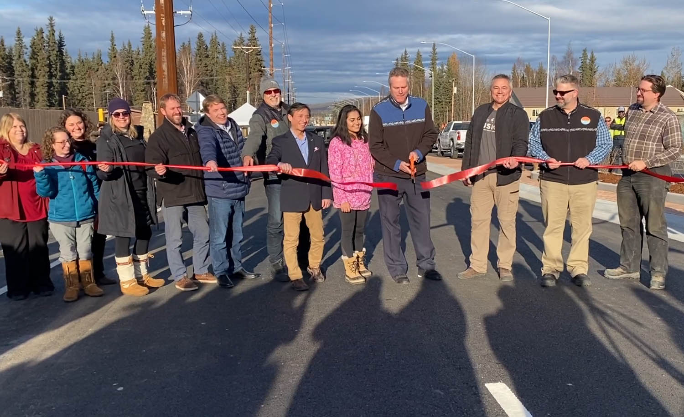
Working together to address challenges: Partnerships
Community Organizations
Local Governments
Private Sector
Federal and State Agencies
Contractors
Governor Dunleavy, Commissioner Anderson, stakeholders, local leaders, and Fairbanks community members at a ribbon cutting celebrating the opening of University Avenue Bridge.

Slide 9
Rural Transportation Planning Organizations (RTPO’s)
Benefits of RTPOs in rural areas:
Supports and enhances the Statewide planning process
Provides a forum for public participation
Insures for the regional and local input
Fostering coordination of local planning, land use, and economic development plans at state, regional, and local levels
Cooperating on the development of the Statewide Transportation Plan, and development of the STIP

Slide 10
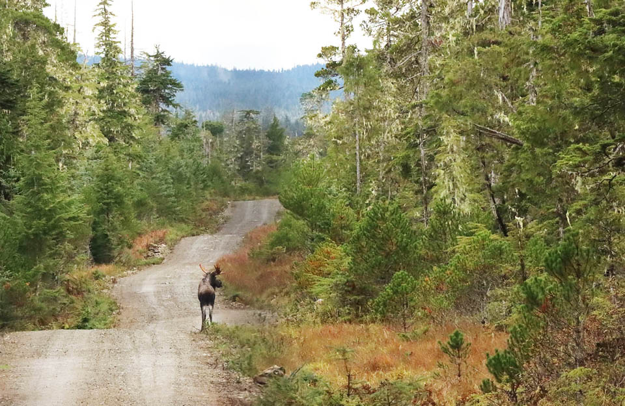
FLAG
Federally-supported, Local Assistance & Grants (FLAG) Program
Provide Local Assistance with Transportation
Establish public-facing websites, materials, and resources to assist communities in seeking DOT&PF’s technical assistance for projects
Moose on Kake Access Road, Krupeanof Island. Photo by Patty Shull, Alaska DOT&PF

Slide 11
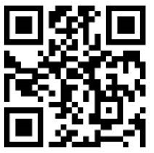
Our New 2022 Survey is Open!
Here’s another chance for the public to weigh in on the future of transportation in Alaska!
Survey deadline has been EXTENDED to April 22, 2022.
Access the survey by scanning the QR code with your smart phone OR visit https://arcg.is/1G4WPD1
Results for 2021 survey can be viewed at: dot.alaska.gov/infrastructureact/results.shtml

Slide 12
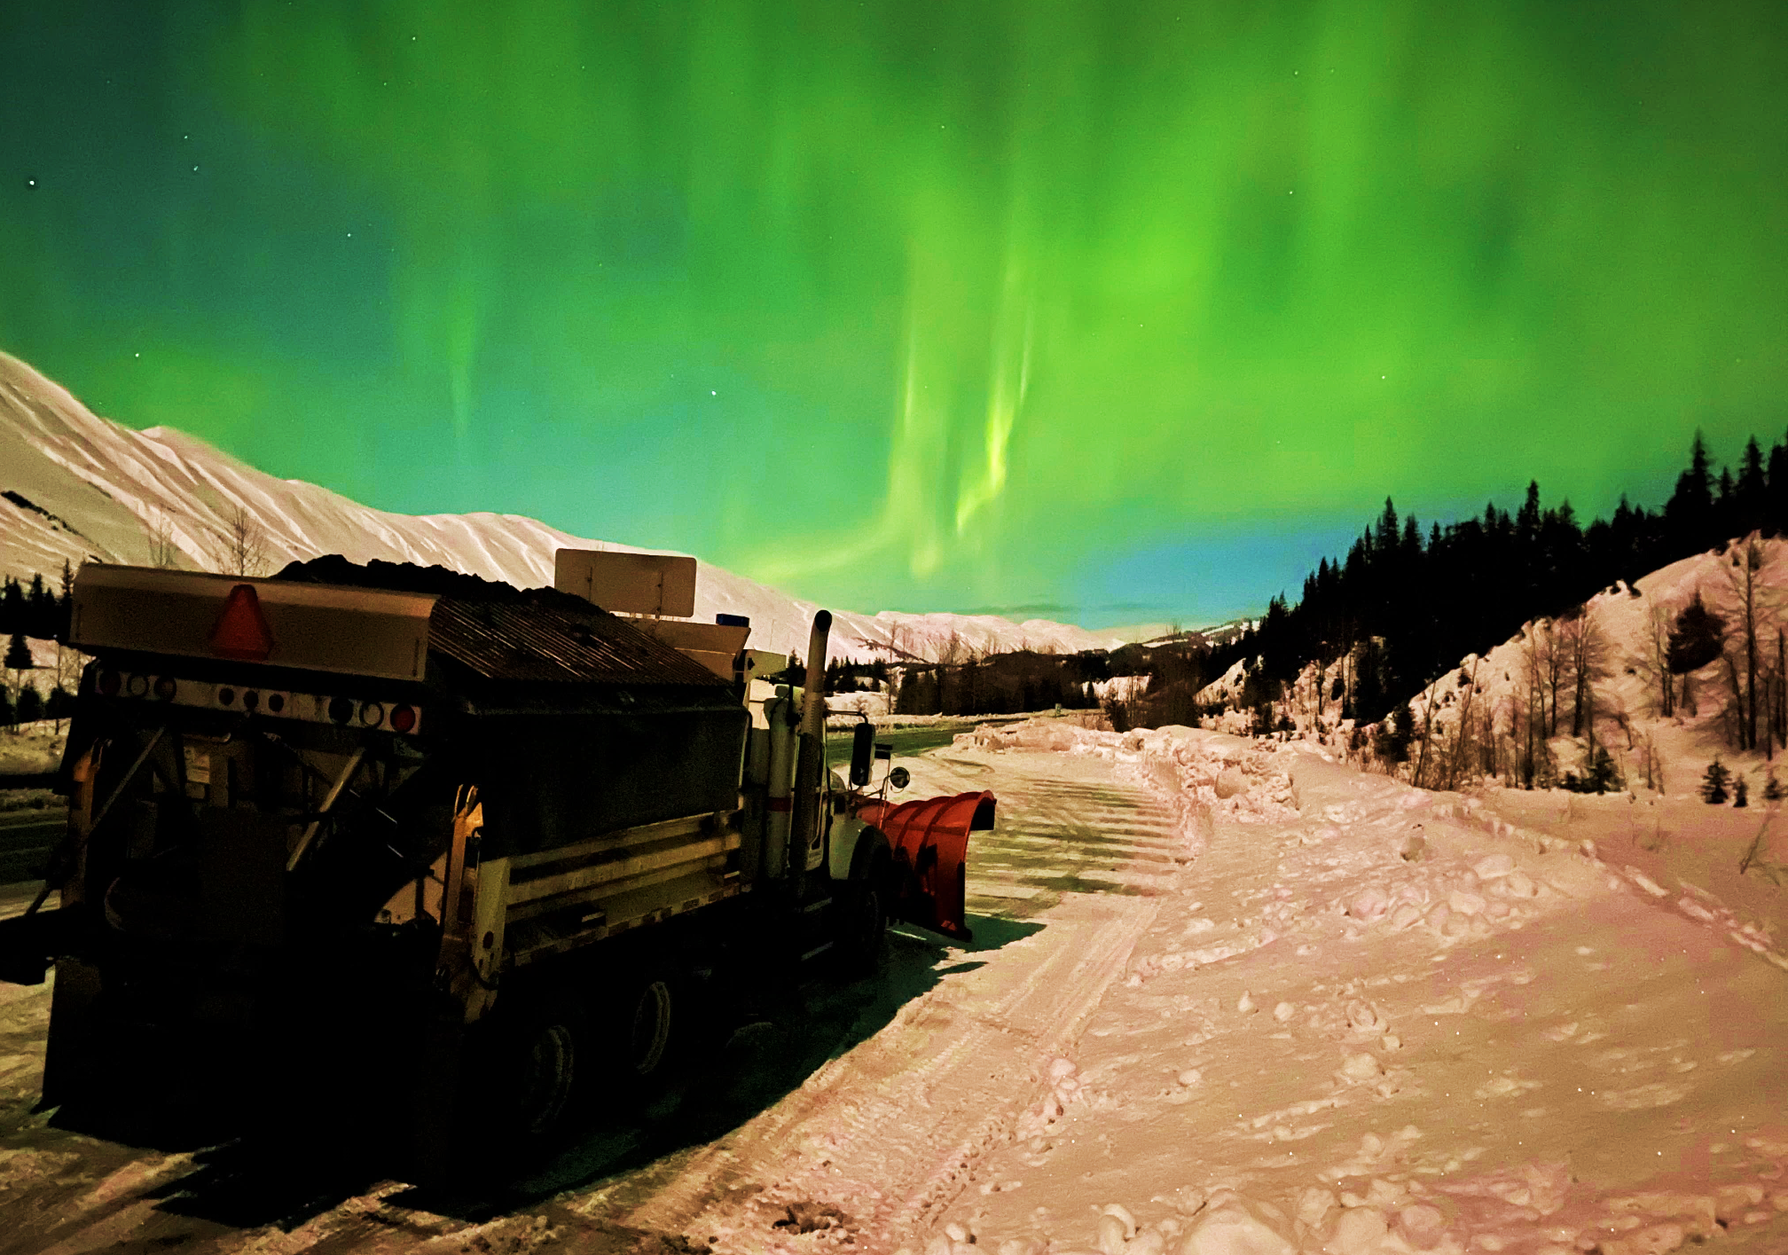
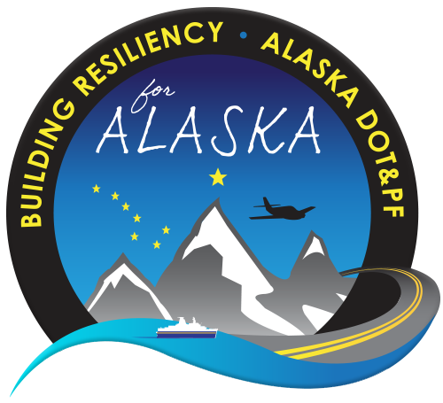
Thank You.
Ryan Anderson Commissioner
907-465-3900 DOT.Commissioner@Alaska.gov
dot.alaska.gov/infrastructureact

